Slide 1
Matrix Mathematics
Learning Objectives
Understand the set of rules that apply to mathematical operations on matrices
Apply arithmetic with matrices using NumPy
Apply multiplication with scalars and matrices using NumPy
Expected Prior Knowledge
Completed prior module ‘Matrices with NumPy’

Slide 2
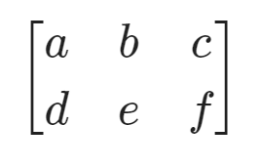
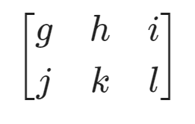

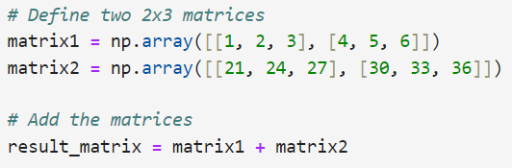


Matrices can be added or subtracted if they have the same dimensions.
Operation is applied between elements in the same position and results in a matrix with the same number of dimensions.
Matrix
Addition & Subtraction
Notes:
Highlight the addition of 1 and 21 , 4 and 30. Then the corresponding elements on the result_matrix
Though the example only demonstrates addition, ask a question to class if there could be any difference with subtraction? Matrices can hold negative numbers just fine.

Slide 3
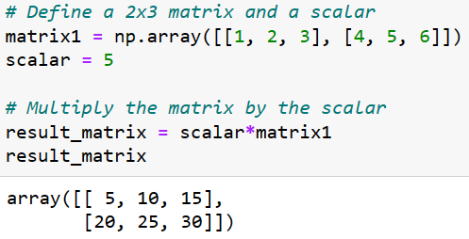
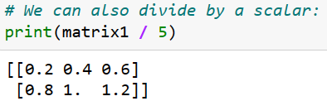
Matrices can be multiplied & divided by a scalar (a single value).
The scalar operation will apply to every element in a matrix:
Scalar
Multiplication
& Division

Slide 4
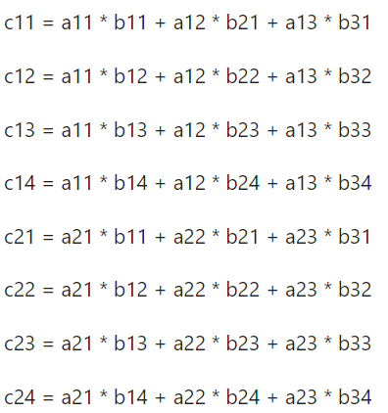

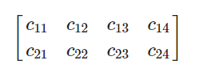
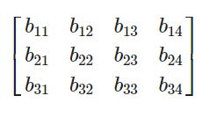

Multiplication follows rules that at first may not be intuitive.
AB is not necessarily the same as BA - the order of multiplication matters.
The matrices must be compatible - A's number of columns must be the same as B's number of rows.
The dimension of the result is A's number of rows x B's number of columns.
Dimensions: (n x m).(m x p) = (n x p)
Matrix
Multiplication
A
AB (order matters)
*
B

Slide 5
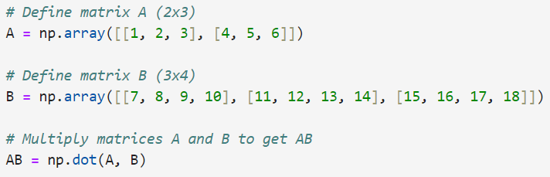
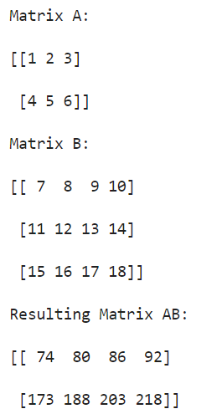
NumPy Example
Matrix Multiplication
Investigate np.dot documentation with
help(np.dot)

Slide 6
1. Create an example that uses at least one 3x2 matrix to demonstrate matrix subtraction.
2. Re-create matrix2 from the earlier example. Calculate:
a. matrix2 multiplied by a scalar
b. matrix2 divided by a scalar
c. i. What does matrix2.ravel() do?
ii. What does np.gcd.reduce(matrix2.ravel()) do?
d. Divide matrix2 by the largest whole number you can that then leaves all elements in the answer as whole numbers.
3. Attempt to do the multiplication BA so you can observe the error produced.
Matrix Exercises
Part 1

Slide 7
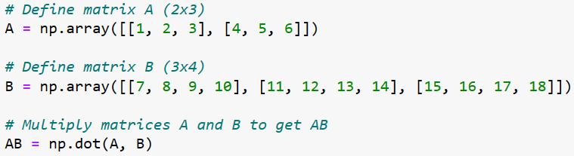
Matrix Exercises
Part 2
4.
a. Re-create the example showing the multiplication AB and multiply the answer by a scalar.
b. Calculate C = scalar*A (using the same scalar as before).
c. Calculate CB. Does it matter if a matrix is multiplied by a scalar and secondly by a matrix, vs. multiplying the matrices and secondly by the scalar?

Slide 8
5. Create a 3x3 matrix C and a 3x3 identity matrix I. Calculate CI and IC. What do you notice?
6. By hand: X is the 3x1 column matrix containing x,y,z. Write down the resulting matrix when the multiplication CX is carried out. Note that each element will be an algebraic expression.
7. Optional: We have used np.dot to multiply two matrices, but there are alternatives. Investigate np.matmul and the @ operator. What are the differences, and when might each method be preferred?
Matrix Exercises
Part 3

Slide 9
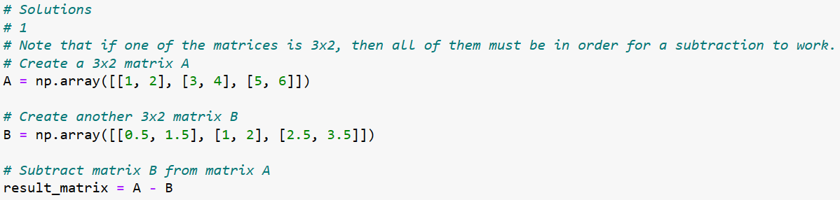
Solutions and Discussion

Slide 10
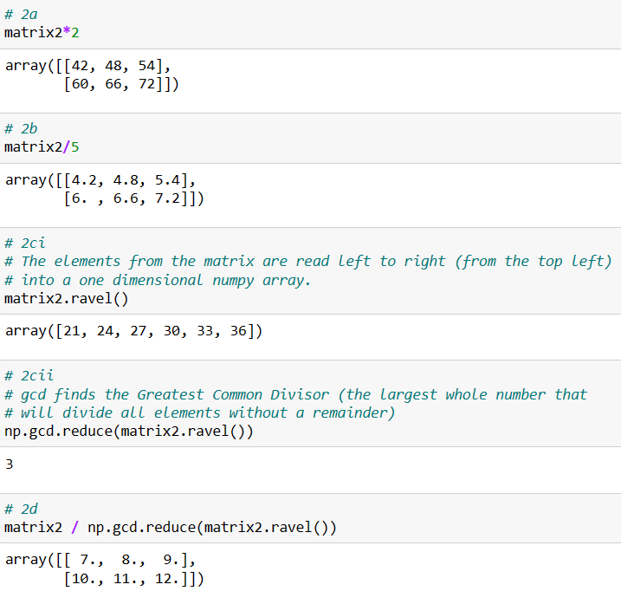
Solutions and Discussion

Slide 11
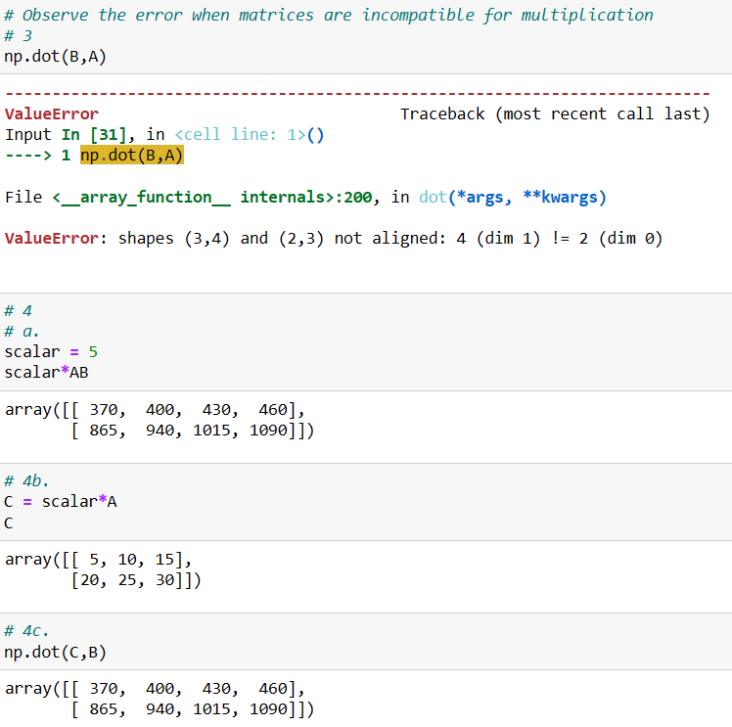
Solutions and discussion

Slide 12
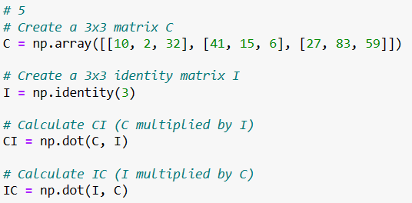
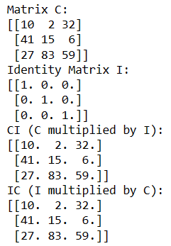
Solutions and discussion

Slide 13
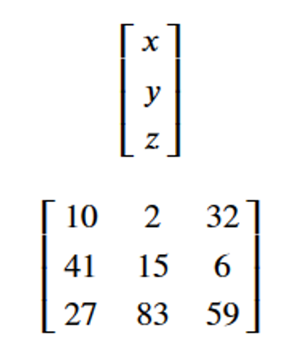
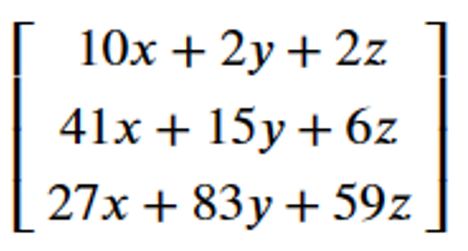
Question 6
Let:
(X) be the 3x1 column matrix: X =
(C) be the 3x3 matrix: C =
The resulting matrix after calculating CX will be a 3x1 column matrix with elements as follows:
CX =
Solutions and discussion
Notes:
Summary
# Notice that the order of multiplication makes a difference!
# Contemplate the solutions to the previous exercise. The result was a set of 3 algebraic expressions.
# We often use this example in order to store algebraic expressions in a way that calculations can be performed.
# Note that the two starting matrices in the question contained the variables x, y, and z, and the grid of coefficients.
# When multiplied together we get back to the set of expressions we might have been considering.

Slide 14
Question 7 discussion
np.dot, np.matmul and @
All these methods will multiply matrices. Check the result of each is the same using two 2 by 2 matrices.
The NumPy documentation states that 'If both a and b are 2-D arrays, it is matrix multiplication, but using matmul or a @ b is preferred.' This is because np.dot behaviour changes depending on the shape of the arrays.
We will use np.dot later with vectors.
Notes:
Show some examples where dot and matmul are same or different, if time.

Slide 15
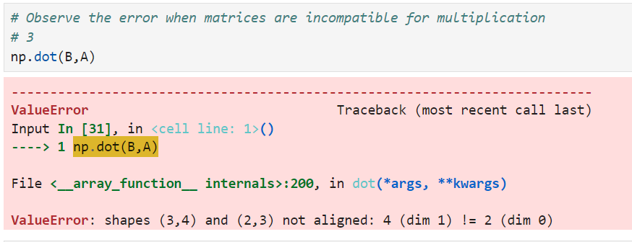
Think about your answers to these questions
Why does the order of matrices matter in multiplication?
Were there any solutions of the previous exercise that are challenging your understanding?
Why did this error occur? (look to np.dot documentation)
Learning check
Notes:
Q5 demonstrated one case where the order of the matrices does not matter, that’s when the dimensions of both matrices are identical.

Slide 16
How did you get on?
Learning Objectives
Understand the set of rules that apply to mathematical operations on matrices
Apply arithmetic with matrices using NumPy
Apply multiplication with scalars and matrices using NumPy

